Slide 1


ANDROID APPLICATION
MODEL

Slide 2

INTRODUCTION
Android applications are programs developed for Android devices.
Android provides a platform to create mobile applications with rich user interaction.
Applications and widgets are placed at the top layer of the Android stack.
Users mainly interact with applications and widgets.

Slide 3
Applications and Widgets Layer
Applications
Widgets
Use the full screen
Interact directly with users
Perform complete tasks
Operate inside a small area of the Home Screen
Show quick information and shortcuts

Slide 4
Producing an Android Application
Android applications are mainly developed using:
Java OR Kotlin
Android does not use Java ME.
Android uses:
* Java SE libraries
*Android-specific libraries
Applications are packaged into:
* .apk files
APK files are installed on Android devices.

Slide 5
Android Application Packaging
APK File
APK stands for:Android Package
APK files contain:Application code,Resources,Assets, Manifest file
APK files are used for:Distribution, Installation of applications

Slide 6
What an Application Would do
Twitter Application Example
Suppose we are developing a Twitter application.
The user should be able to:
Post status updates
View friends’ activities
Login using username and password
Required screens:
Login Screen
Status Update Screen
Friends Feed Screen

Slide 7
Background Processing and Services
To make the application faster and work without internet:
Data is downloaded when internet is available
Data is stored locally using cache
The application uses:
Background Service
Local Database

Slide 8
Background Service
Database
Runs in the background
Updates information automatically
Starts when the device turns on
Stores data locally
Helps in faster access
Supports offline usage

Slide 9
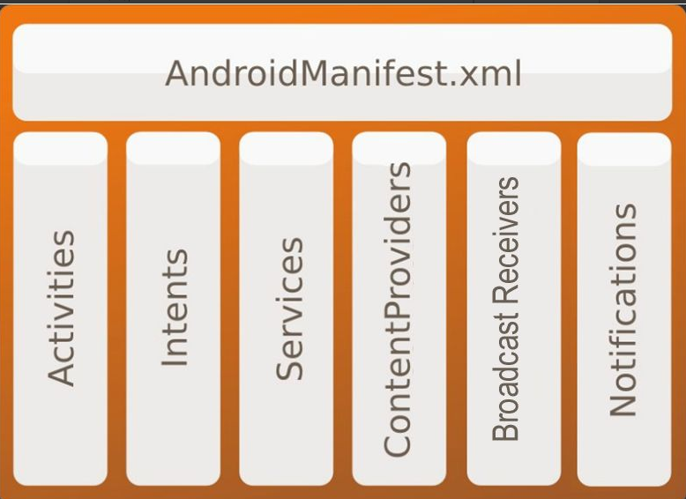
Application Components
Android applications consist of loosely coupled components, bound using a project manifest that describes each
component and how they interact.

Slide 10
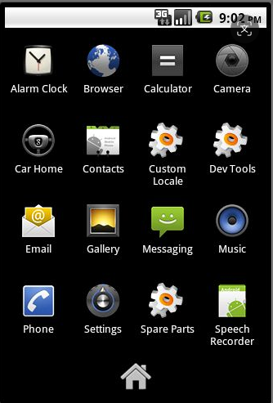
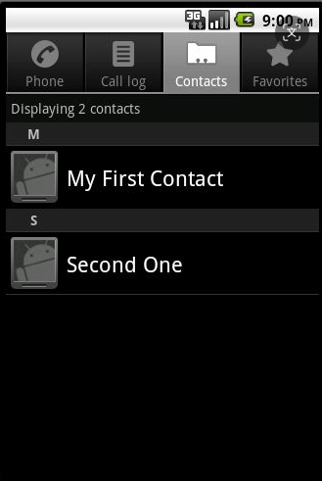
Activity and Views in Android
Android applications usually contain multiple screens called Activities.
Each activity has:
* Its own window
* Its own lifecycle
Moving to another screen starts a new activity.
Activities can return data to previous activities.

Slide 11
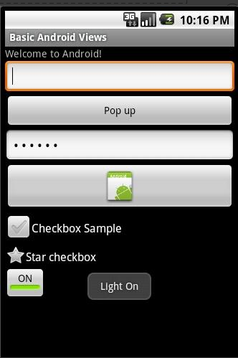
Android Views
The UI of an activity is created using Views.
Android provides built-in views such as:
* Buttons
* Menus
* Text Fields
Users interact with activities through views.
Views respond to user actions and events.

Slide 12
Intents in Android
Intents are message objects used for communication between Android components.
They are used to request an action such as:
* View
* Edit
* Delete
* Dial
* Pick

Slide 13
Types of Intents
Explicit Intent
Implicit Intent
Specifies the exact component or activity to open.
Used mainly inside the same application.
Does not specify the target component directly.
Android system automatically finds the best application to handle the request.

Slide 14
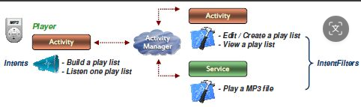
Intents Filters
Intent Filters allow components to declare their capabilities.
They help Android decide which component can handle an intent.

Slide 15
Services in Android
A Service is a long-running background task in Android.
Services run in the background without a user interface.
They are used for tasks like:
* Music playback
* Downloading files
* Background data updates
Started Service
Started using startService()
Runs independently in the background
Bound Service
Started using bindService()
Allows interaction between the service and other components like activities

Slide 16
Content Providers in Android
Content Providers are used to share data between Android applications.
They make application data available to other apps.
Applications communicate with Content Providers using a ContentResolver.
Provide methods to:Insert data, Update data, Delete data, Query data
Support different types of data storage such as:SQLite Database, Files, Other storage methods
Applications do not access data directly.
They use a ContentResolver object.
Android identifies data using: Content URI, MIME Type

Slide 17
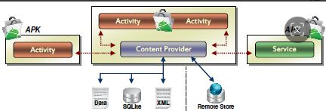
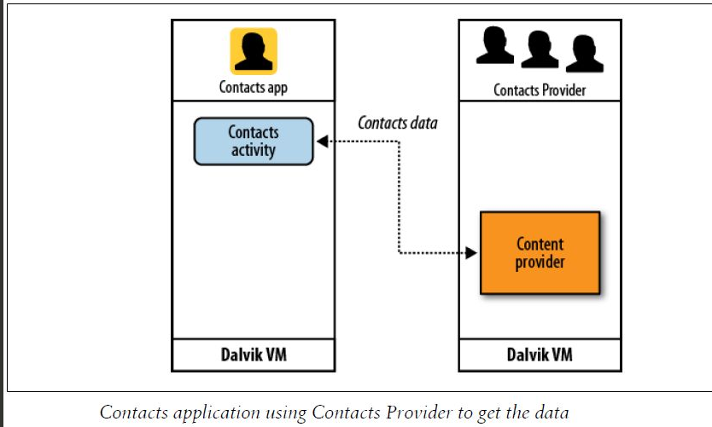

Slide 18
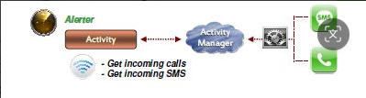
Broadcast Receivers in Android
Broadcast Receivers are used to listen for system or application events.
They extend the BroadcastReceiver class.
Common system broadcasts include:
Low battery
Time zone change
Network change
Features
Broadcast Receivers do not have a user interface.
They can:Start an activity,
Show notifications to users

Slide 19
Notifications in Android
Notifications are used to alert users about important information.
A small icon appears in the status bar for user interaction.
Users can tap the notification to view details.
Features
Play sounds
Vibrate the device
Flash lights
Show status bar icons
Notifications are the preferred way to get the user’s attention.

Slide 20
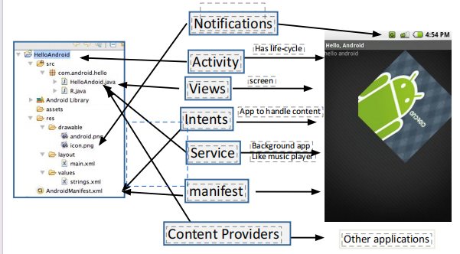
AndroidManifest.xml
Android must know about application components before starting them.
Components are declared in the AndroidManifest.xml file.
Components Declared in Manifest
* Activities
* Services
* Broadcast Receivers
* Content Providers

Slide 21
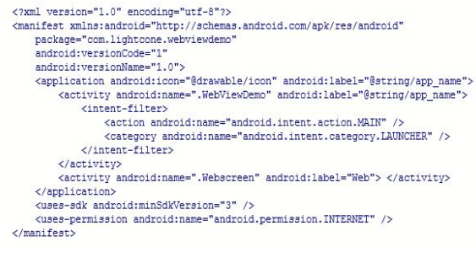
Features of Manifest File
It is a structured XML file.
Every Android application must contain this file.
It defines:
* Application components
* Required libraries
* Permissions needed by the application.

